Slide 1


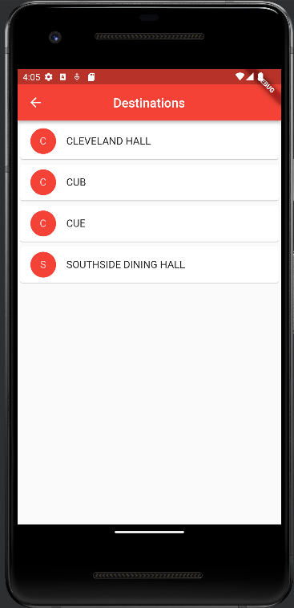
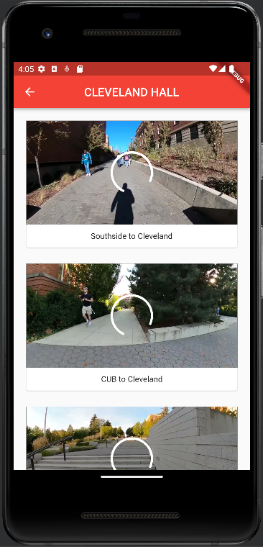
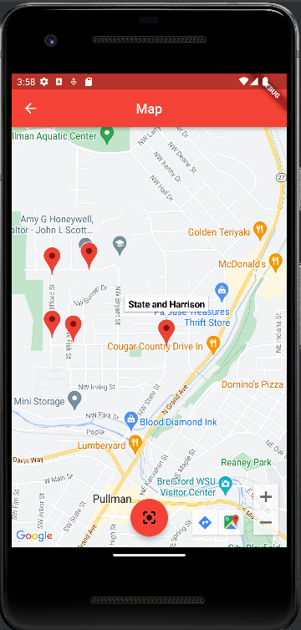
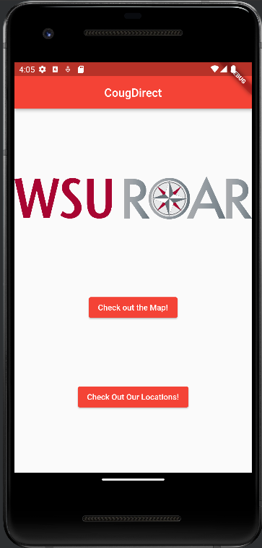
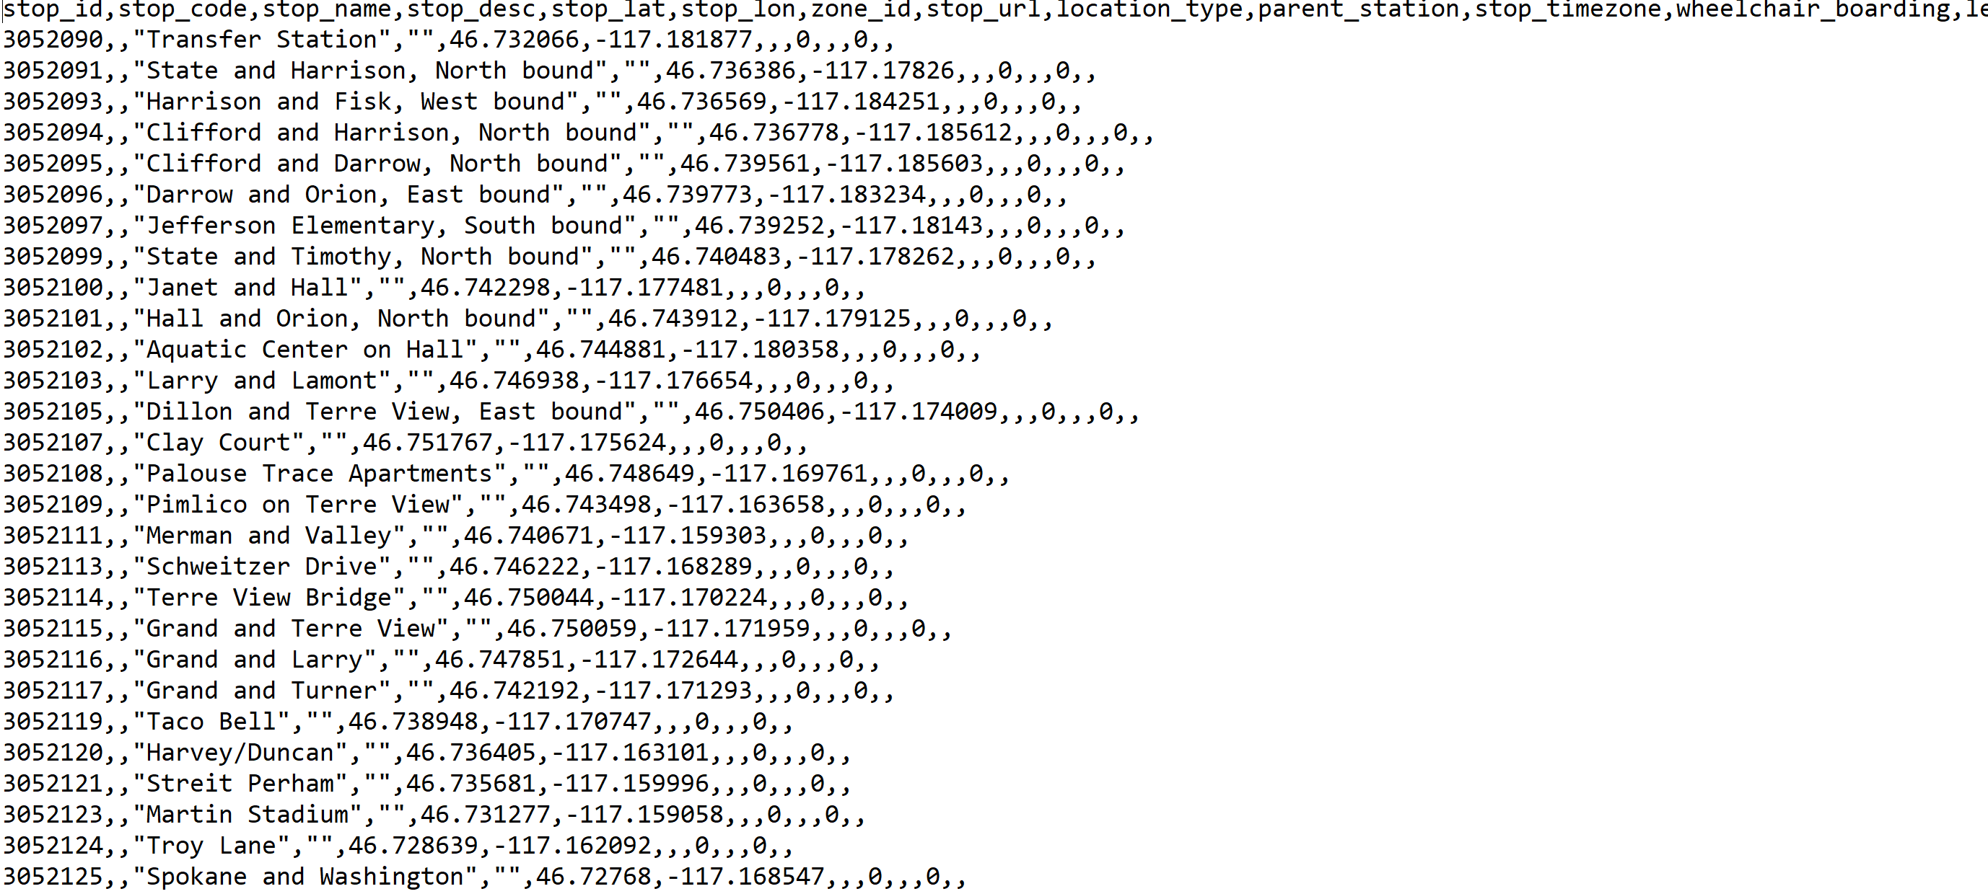



WSU ROAR Mobile Application Sponsor: WSU ROAR Mentor: Katie Abrams Alex King, Martin Bui, Yurun Han
Overview:
Our app is designed for the WSU ROAR program, a program for students with mental disabilities. Our application will help these students navigate campus more effectively and help them establish a routine with their walking routes. Additionally, this application will help students navigate the transit system, and help them get to the grocery store, their apartments, etc.
The app’s map page opens to the image on the right. Many businesses are not included in this map, and it added the stops to the following bus routes:
Wheat
Blue
Apartment Land Express
Campus Loop
The app opens to the page on the right. A main goal of our app was to make it as user-friendly as possible, as instructed by our client.
This led to us keeping the amount of buttons per page to a very low amount, so it can be as underwhelming as possible to the user.
Glossary:
Android: Operating system created by Google for a large number of smartphones
iOS: Apple operating system for iPhones and iPads
API: Application programming interface, a way for machines to communicate with one another and access data from one system to another
Flutter: Framework to build applications that allows for cross-platform development
Dart: Programming language used by Flutter, very similar to Java and Kotlin
Sample view of the map
List of hotspot locations
Collection of videos to and from that location
There is a collection of videos that show the user an efficient walking path from some of these hotspot locations for ROAR students to another. Cleveland Hall is home to the ROAR lounge, where all ROAR students can go to relax and study between classes, so we have videos connecting many buildings on campus to Cleveland Hall.
Below is a sample of the stops.txt dataset that contains the bus stops in Pullman Transit. This data comes from GTFS.
The application is designed using the Flutter framework and written in the Dart programming language. This allowed us to export one project to both iOS and Android devices without having to create two separate projects. We also used the Google Maps Platform to create a reliable map with these specific locations on display.
Acknowledgements:
We want to thank our client/mentor, Katie Abrams, for all of her support and help this semester. We also want to thank the students of WSU ROAR for assisting us with filming our videos and testing our application.
The application’s home screen
CougDirect

